Slide 1

Building a Secure and Decentralized Messaging App with Actor-Based Communication on the Blockchain

Slide 2
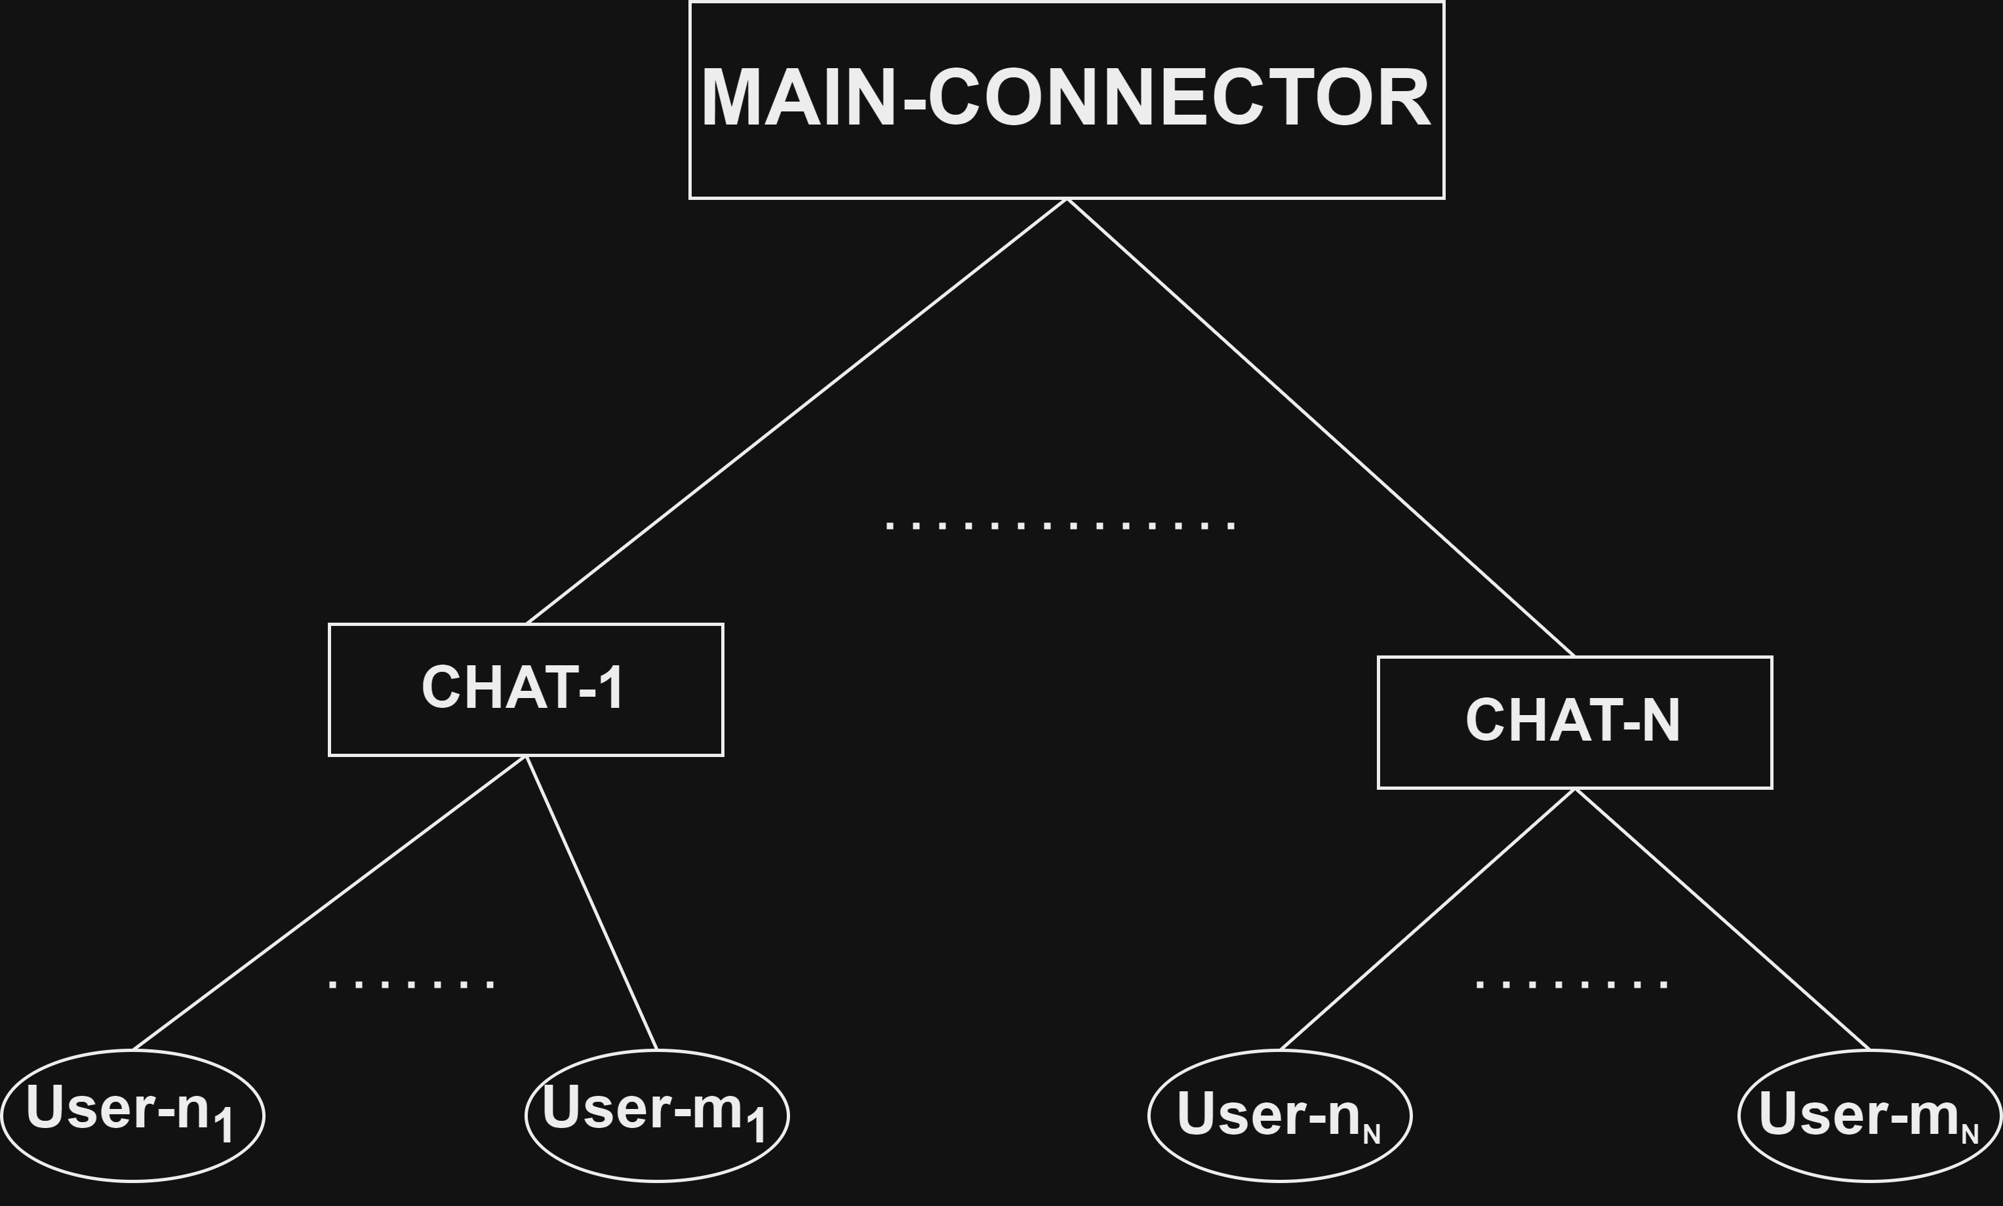
distributed messenger with central Main contract creator
Benefits of distributed Messaging Dapp :
Privacy: Messages are end-to-end encrypted, ensuring confidentiality and protecting user data
Decentralization: The absence of a central authority empowers users and promotes censorship resistance
User Control: Users have ownership of their data and cryptographic identities, promoting data sovereignty
Issues:
Everyone can see with whom and how often you communicate (but they don’t see the content)

Slide 3
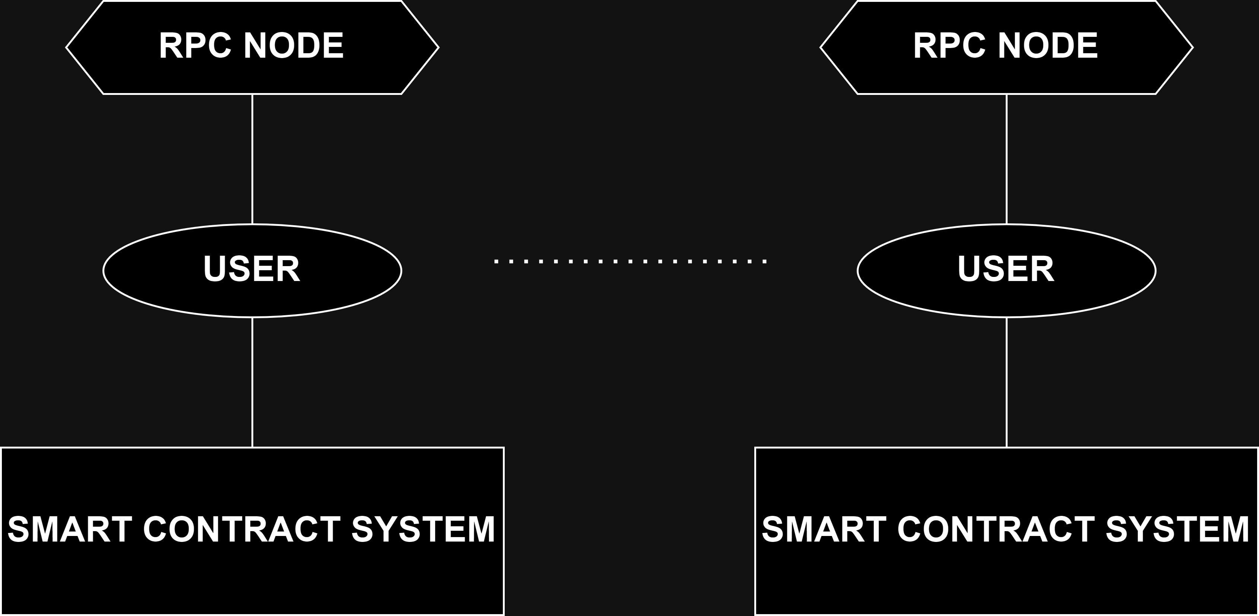
Distributed messenger with secure chat participants
Everything that the user does, he does exclusively in his contract
Every state that the user reads, he reads exclusively from its own node
The main problem is how to establish secure connection

Slide 4
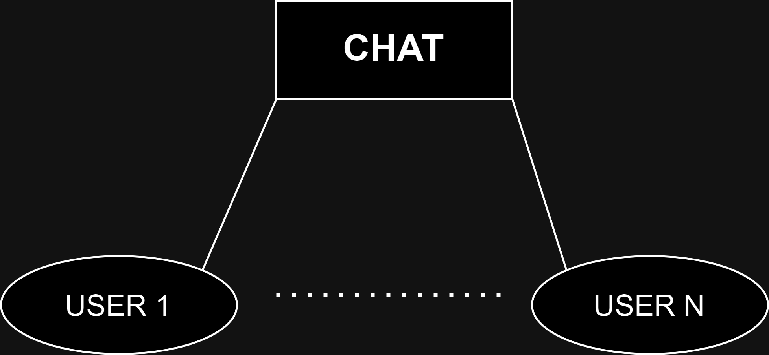
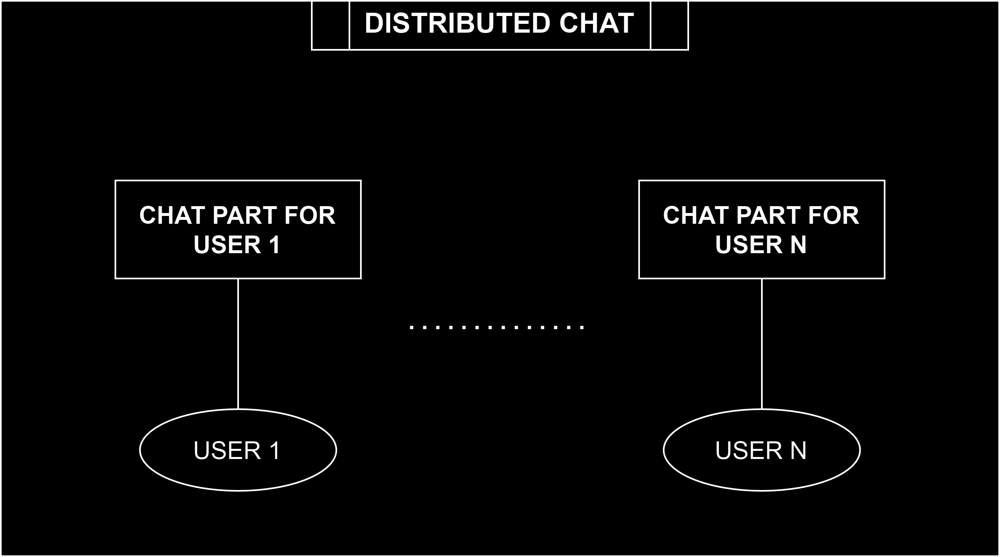
Why user must write only in its own space
Since it's a blockchain, everyone can see what you're doing and what contracts you're sending messages to, so it's easy to find out chat participants.
Every participants of the (distributed) chat writes messages in its own chat part and other users must know what contract state they must read to get your messages.
So main problem is how to tell other participants about location of your chat part

Slide 5
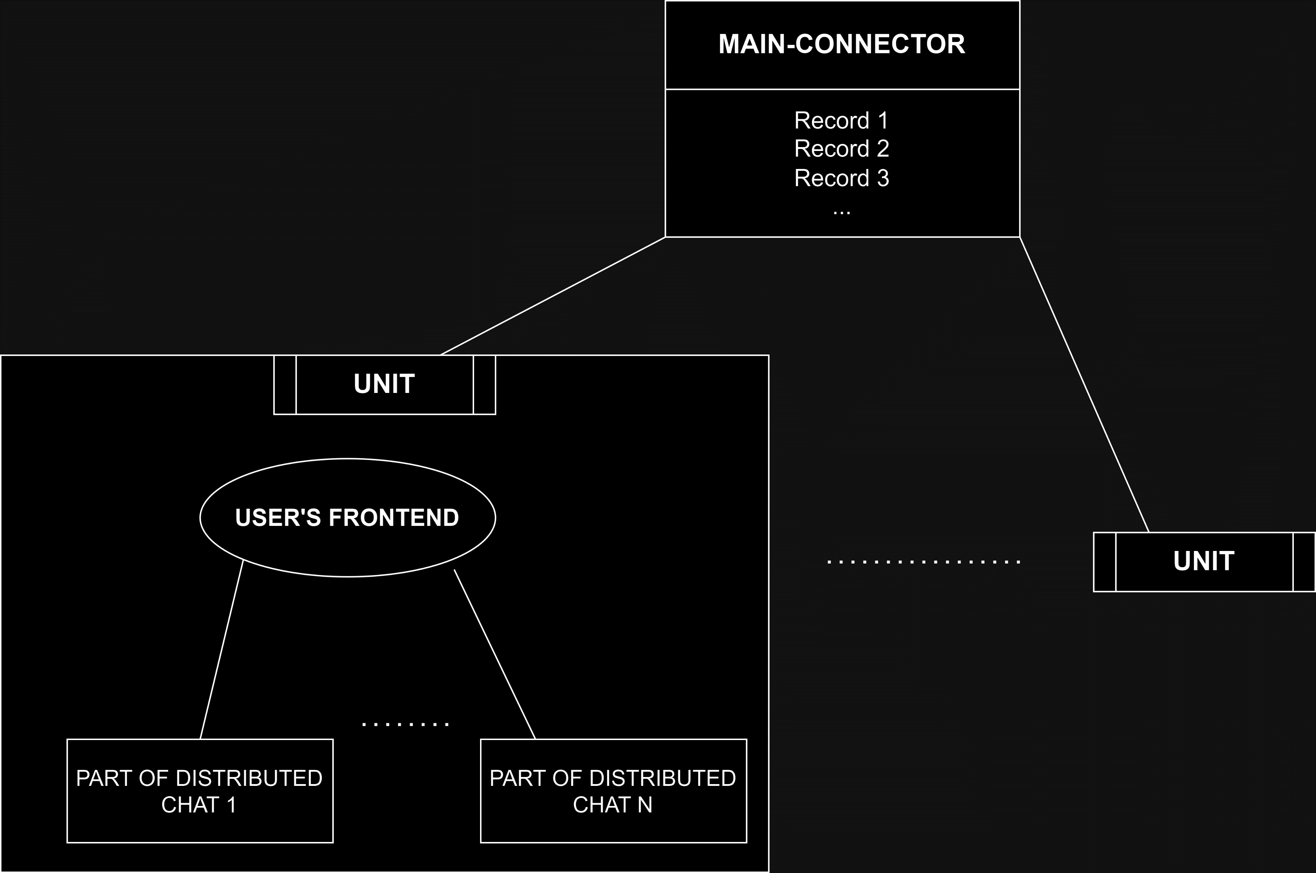
Example of such messenger
Main-connector: Connections are established via it, but it has no smart contract logic at all, we can even consider it just as the storage for records
User’s frontend: Keep order of distributed chats and handles all connection logic

Slide 6
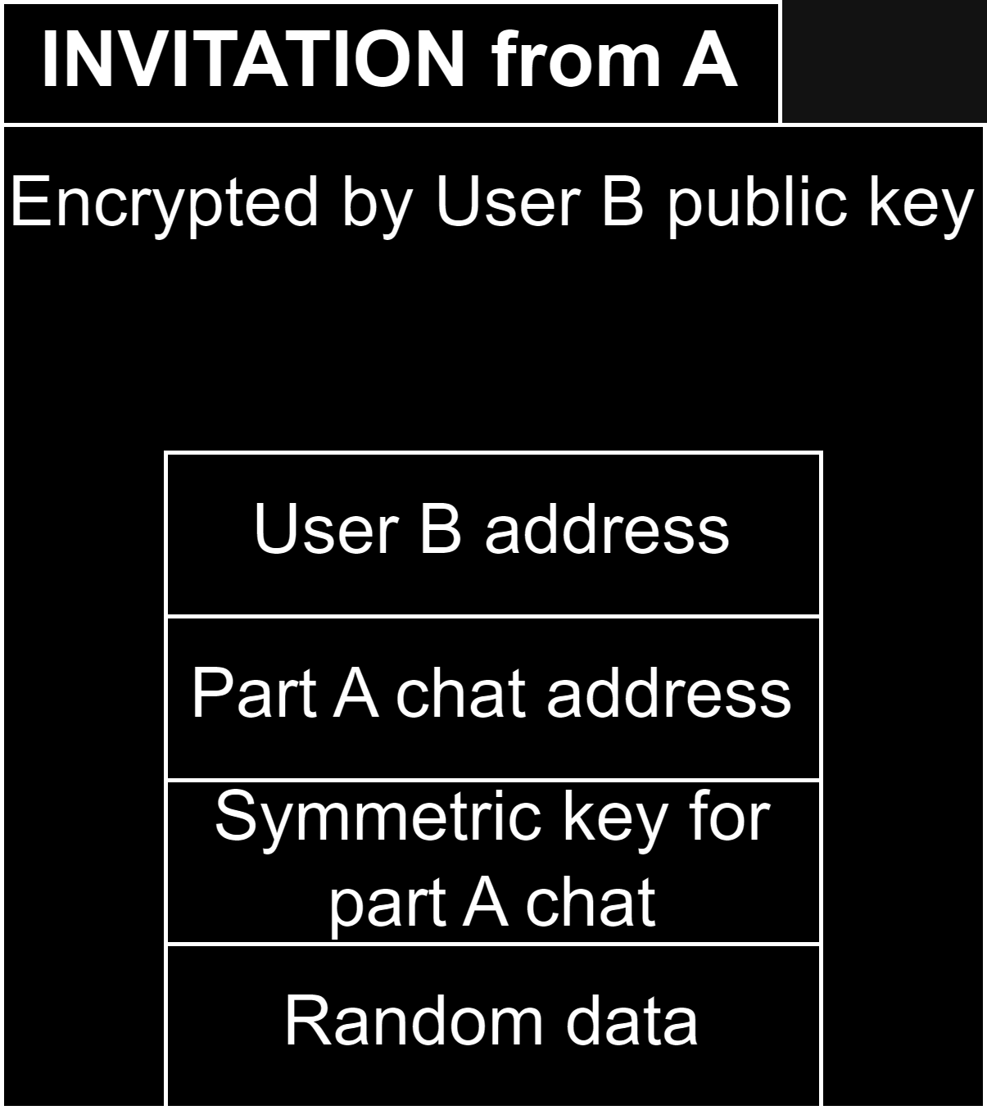
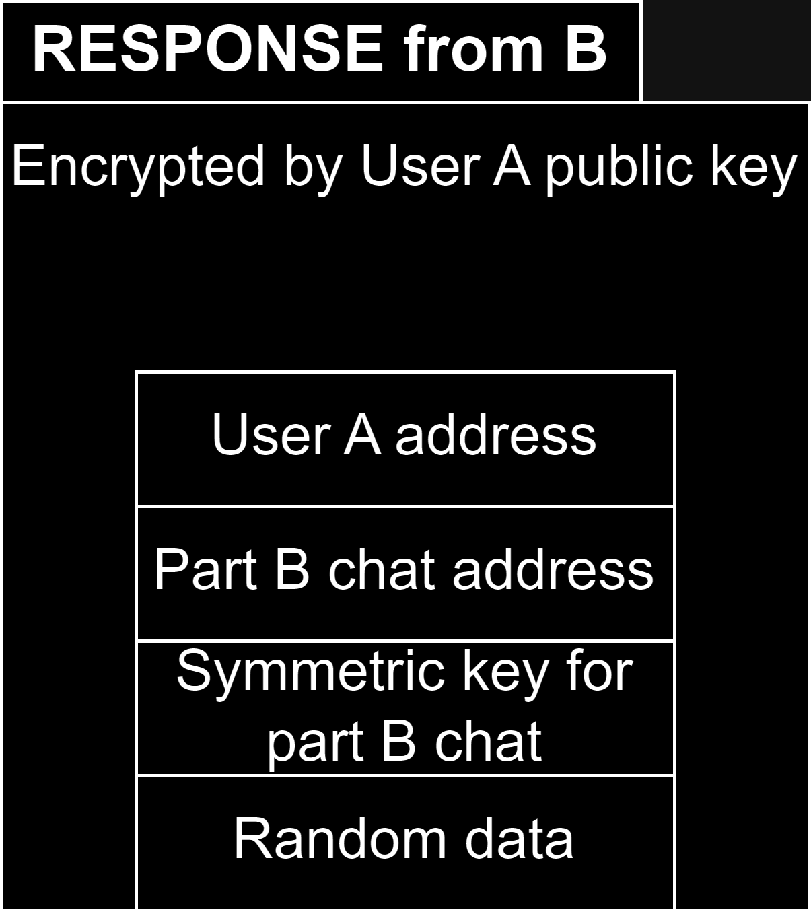
User A establishes connection with User B
1. User A creates his part of the chat, part A for example. Also he generates symmetric key for this chat part
2. User A write an invitation record in the MAIN-CONNECTOR
3. User B scans all records from MAIN-CONNECTOR and decrypts them by his private key if he got his address then he knows that this was made on purpose and now he knows that User A wants to chat with him and here is his chat part and symmetric key
4. User B write response on User A invitation as a record in MAIN-CONNECTOR

Slide 7
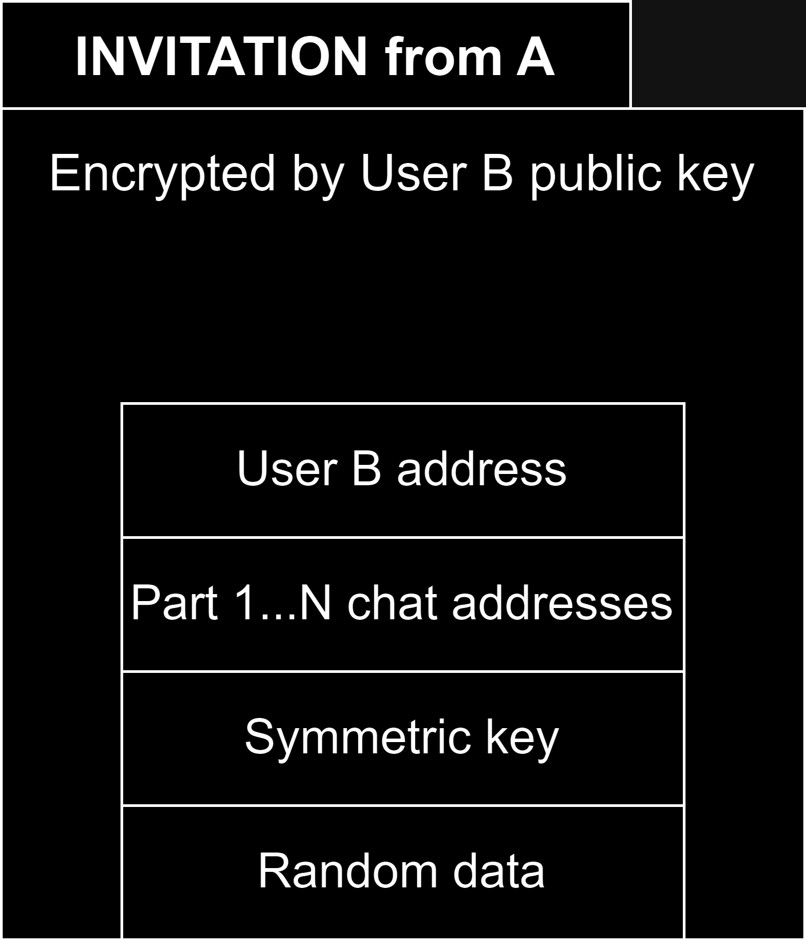
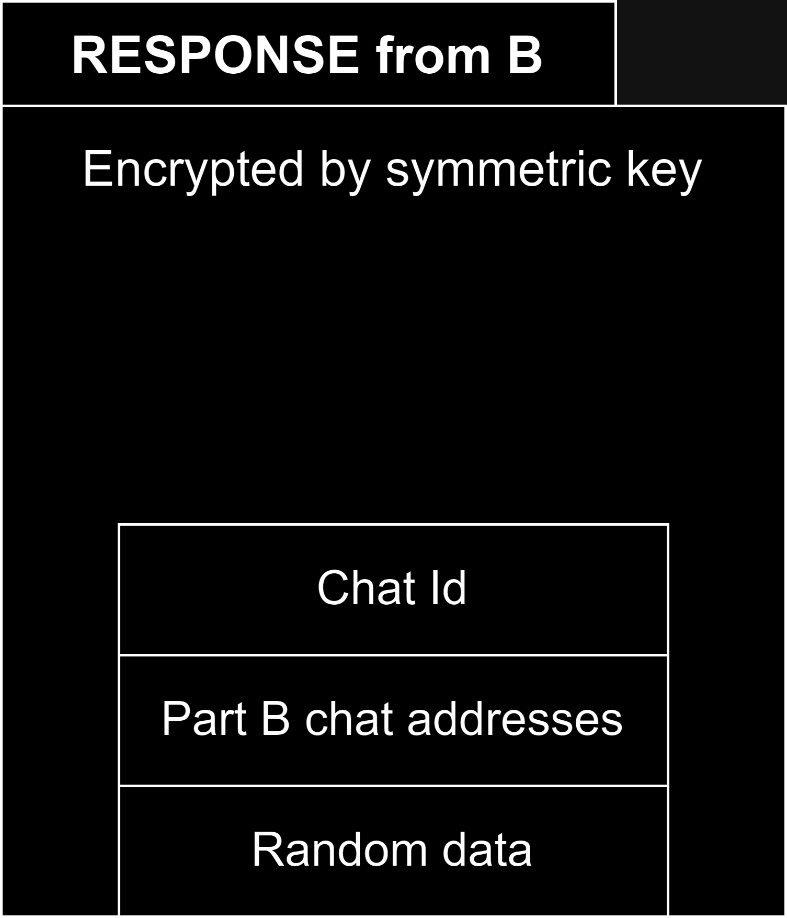
User a invites user b in chat with other users 1 … n
1. User A write an invitation record in the MAIN-CONNECTOR
2. User B now see invitation from User A into this new chat with these participants. So User B allocate new space for his part of that chat.
3. User B write response on User A invitation as a record in MAIN-CONNECTOR
4. Now all users 1…N can decrypt this response and see where user B will write its messages

Slide 8
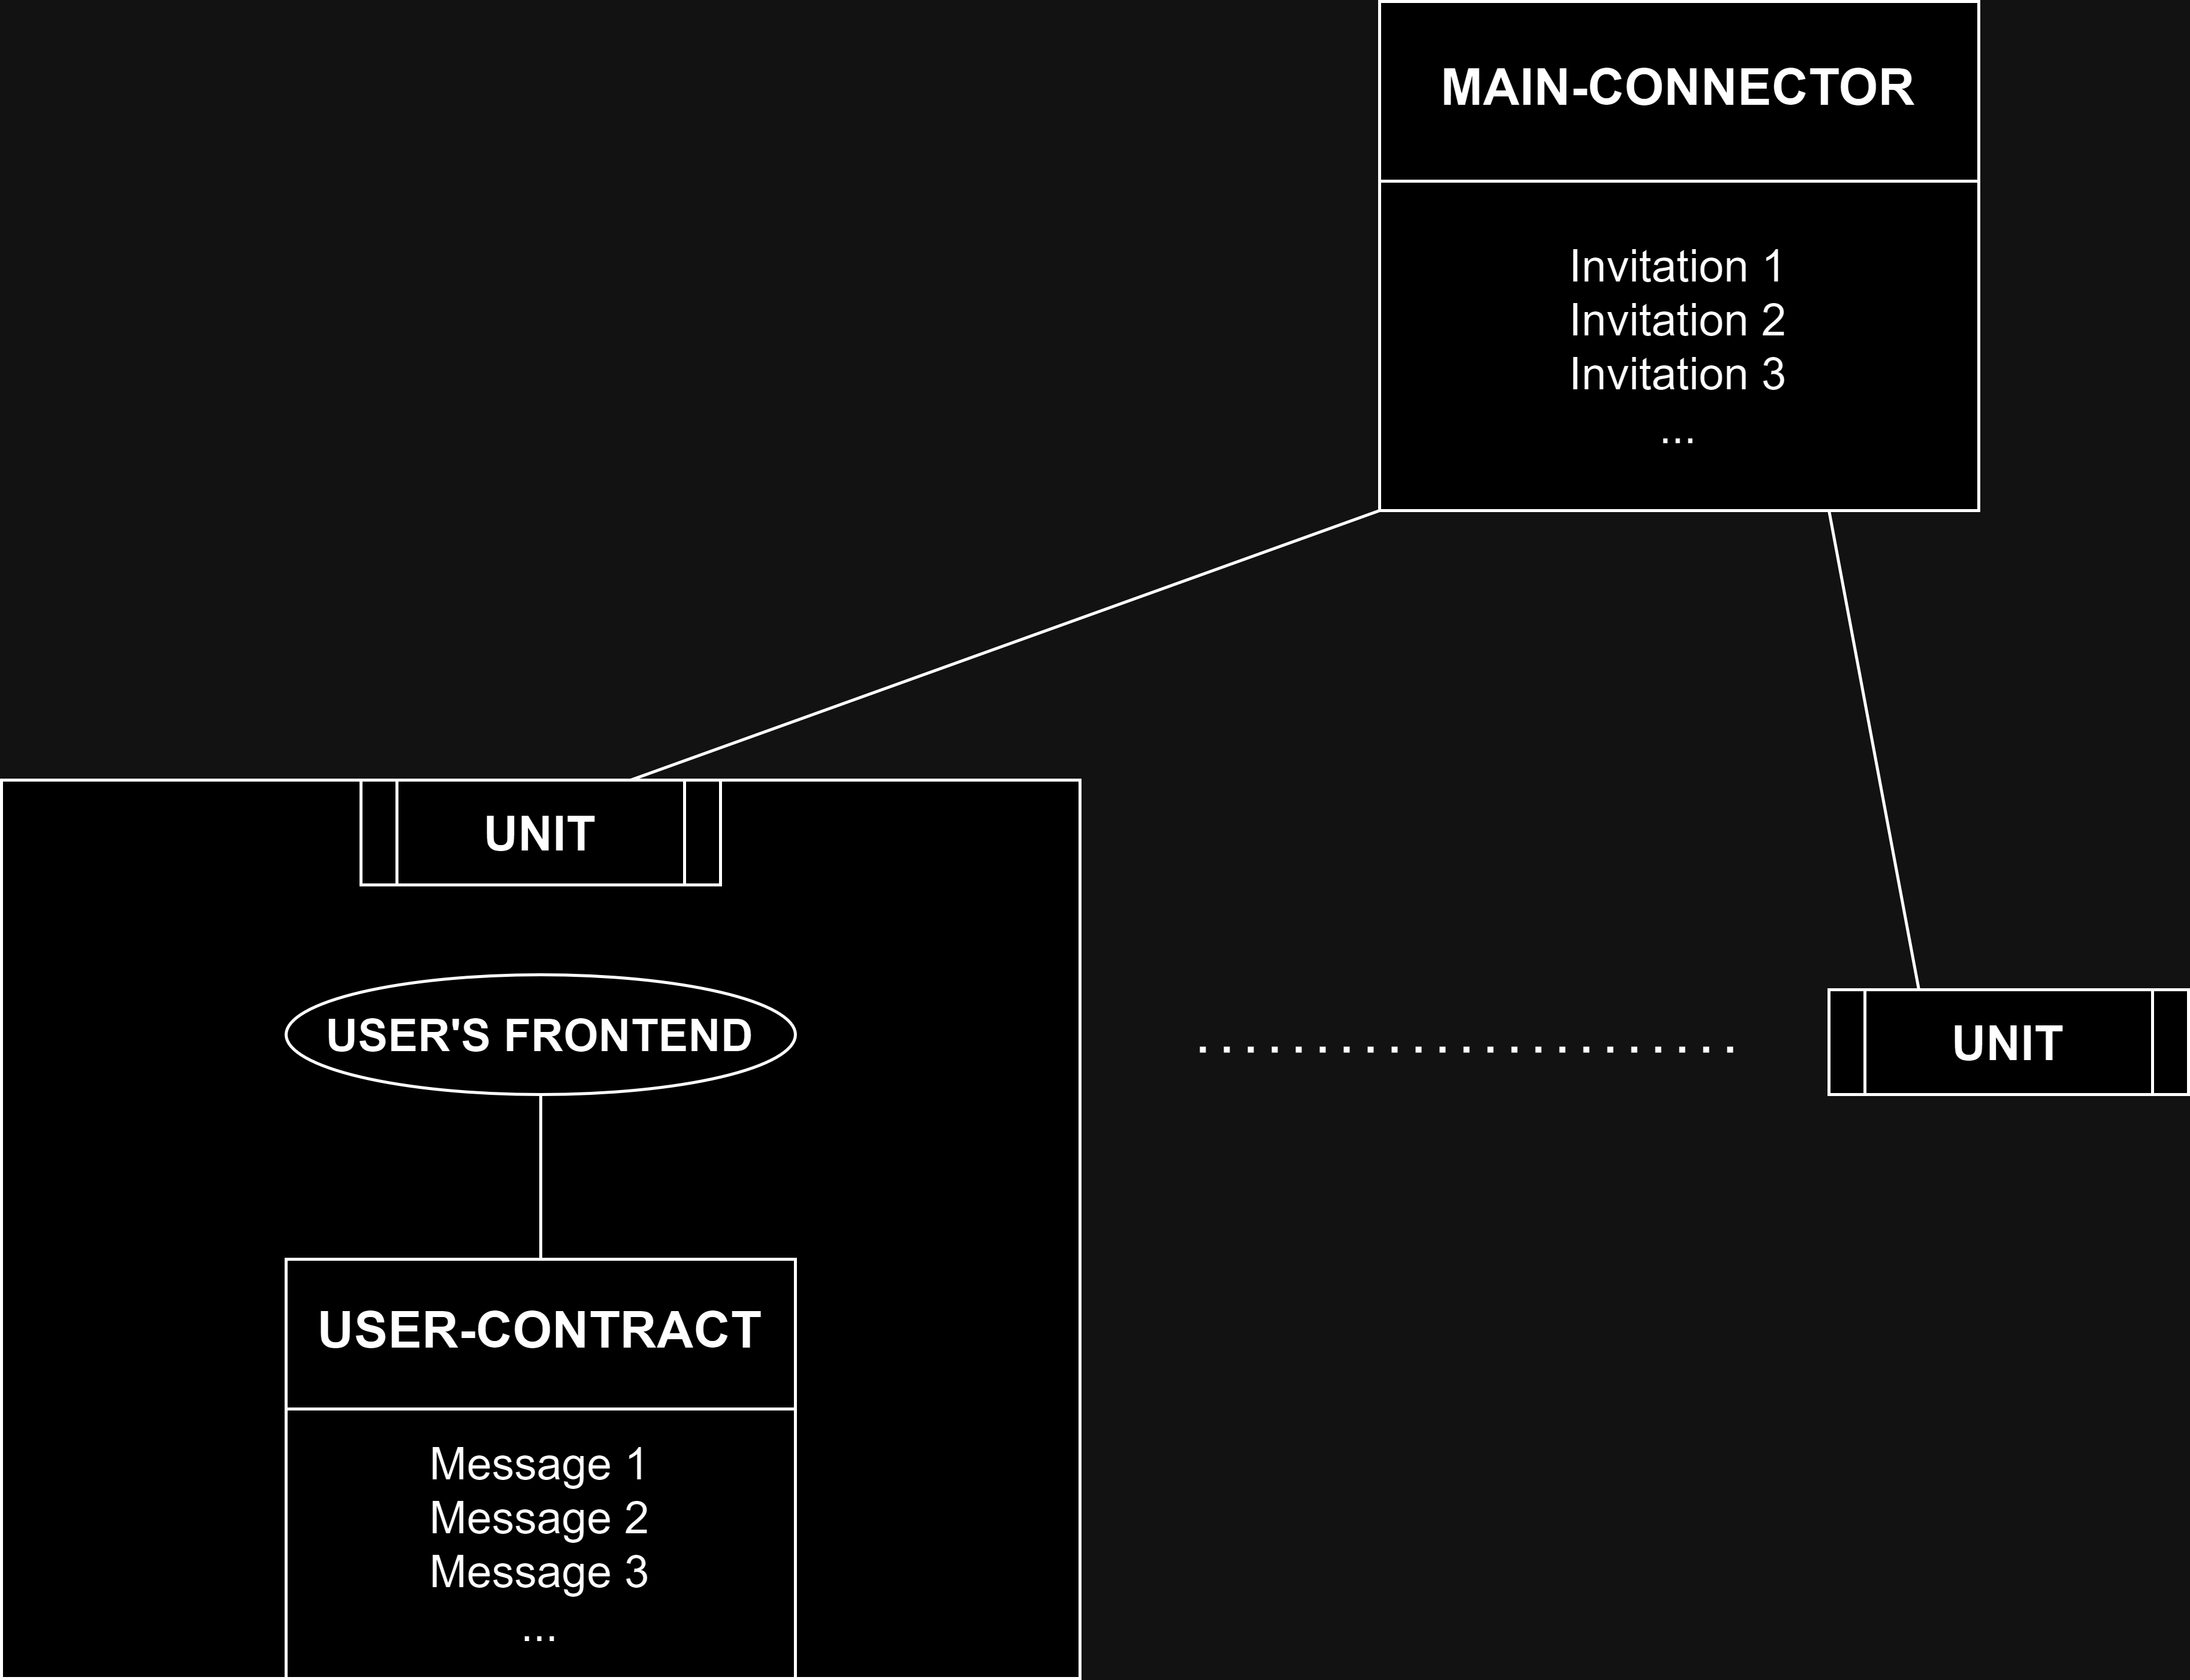
new approach without responses
Main-connector: Storage for invitations
User-contract: Stores all messages for all chat parts in one big list, but via messages now possible to response to invitation

Slide 9
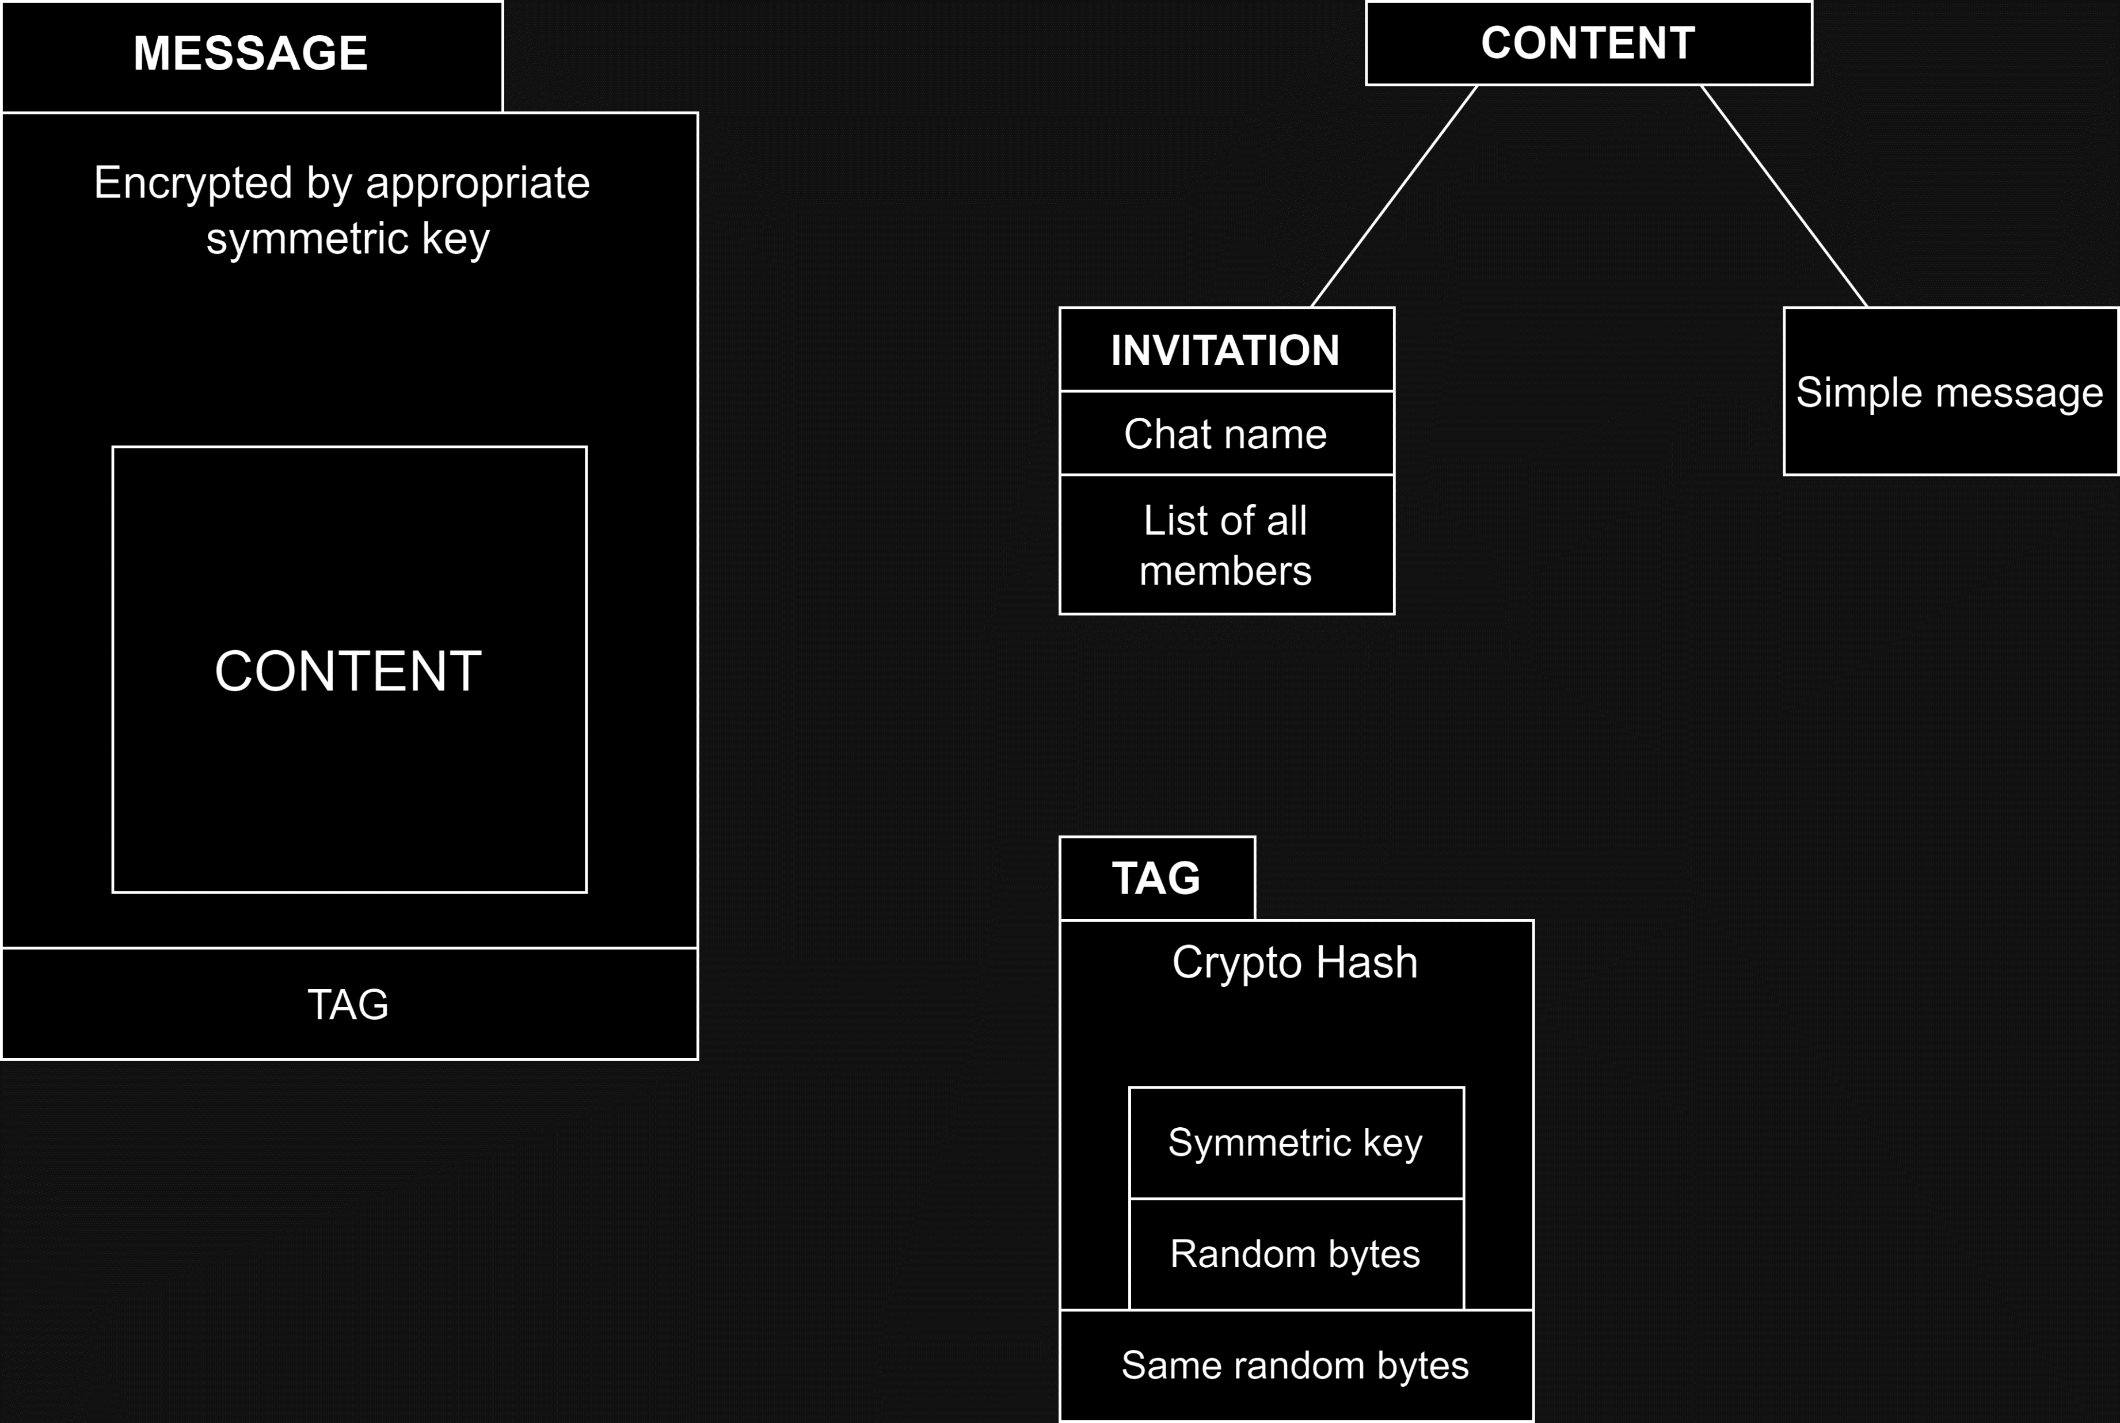
Internals of user-contract
All messages looks like a random data and only for intended users they are means something useful after decryption
Tag is just small peace of bytes that helps right users quickly find the right messages
(tag verification takes about one micro second on my quite simple laptop, so it’s one million tag checks per second)

Slide 10
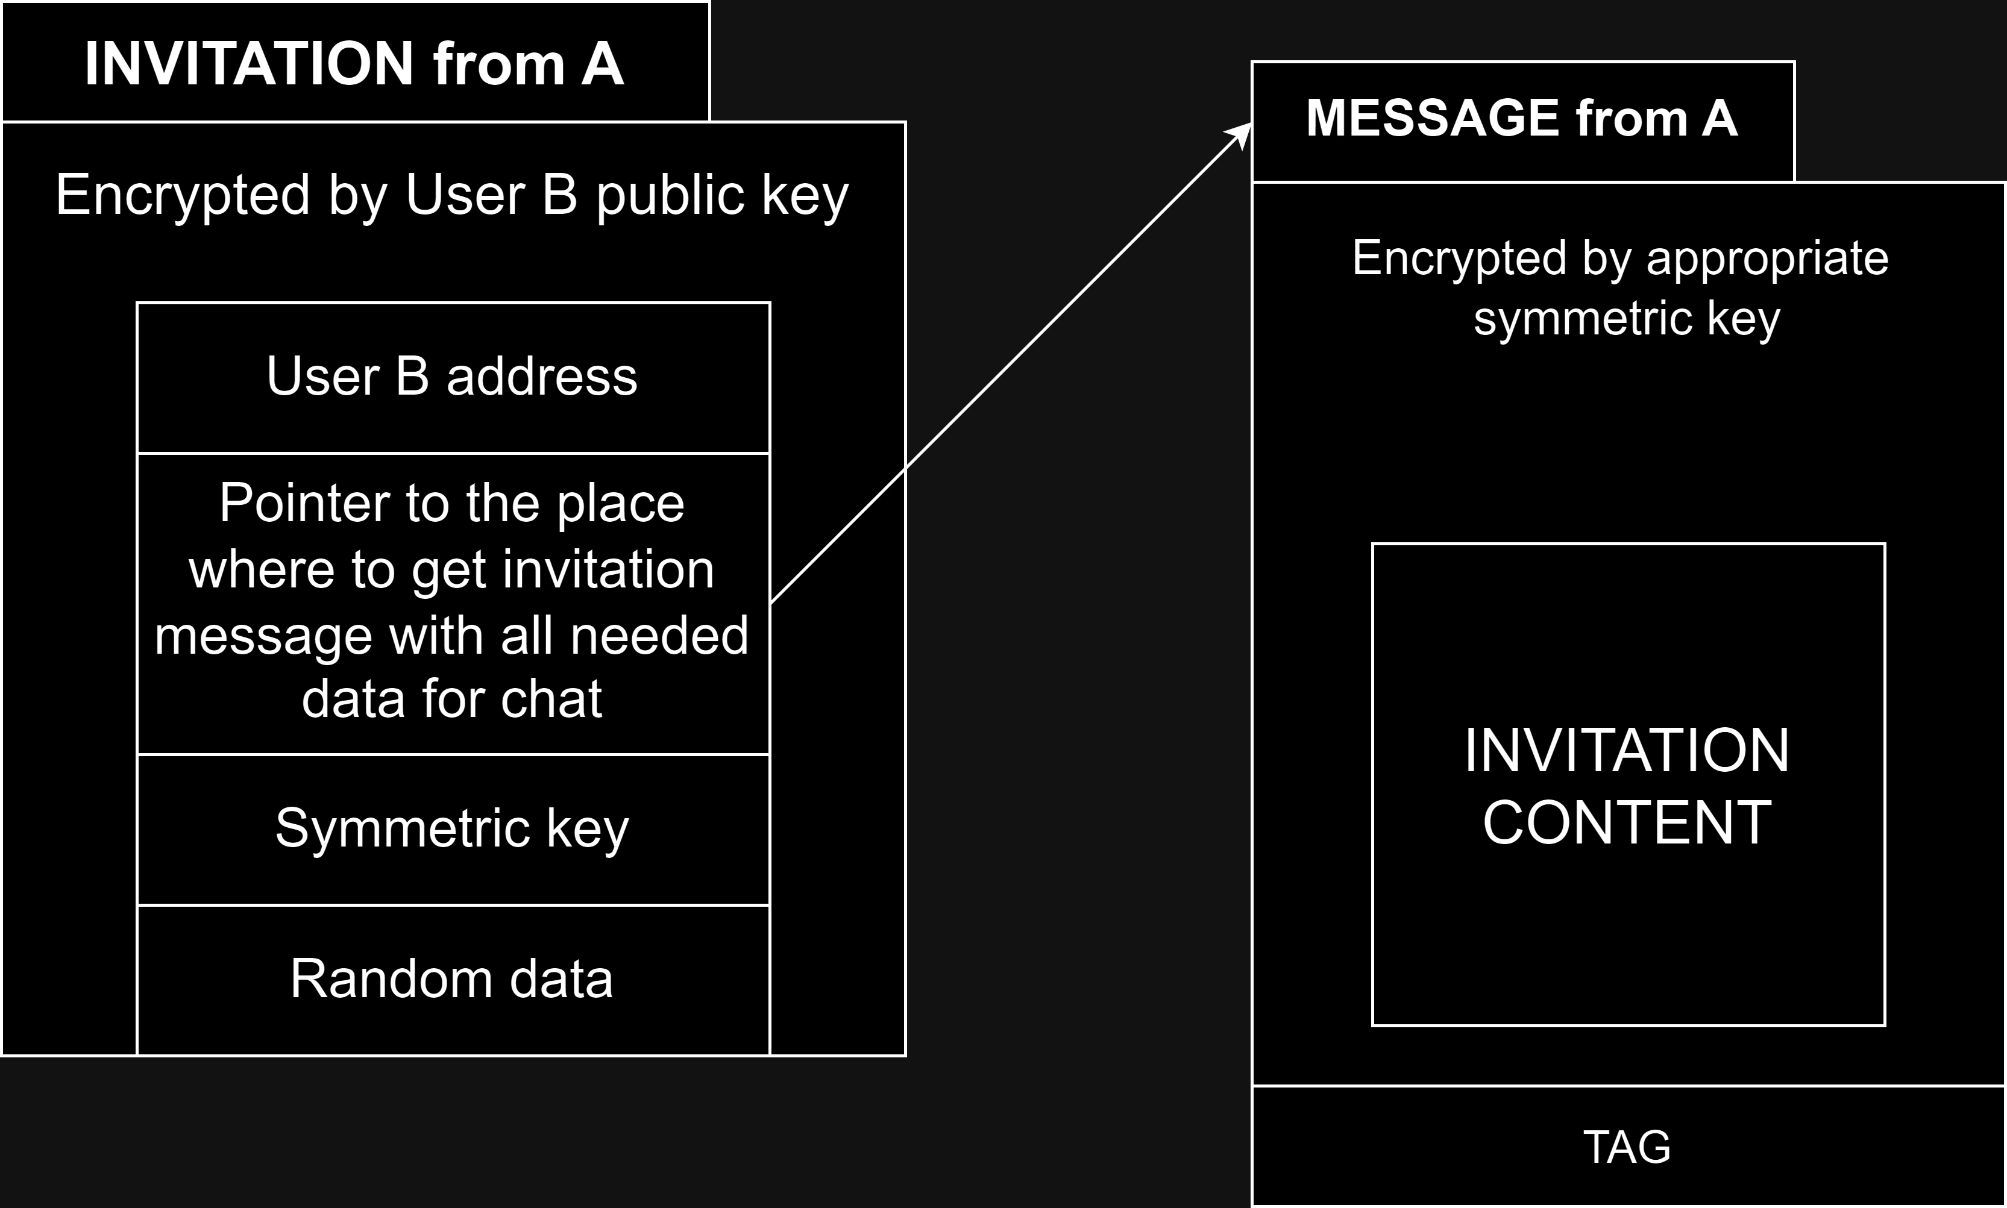
New type of invitation
User B receives an invitation from Main-Connector
Then follows the pointer in the invitation and decrypts the information received from the pointer, thereby obtaining all the necessary information about the chat and its participants
User B's frontend sets up everything for the new chat

Slide 11
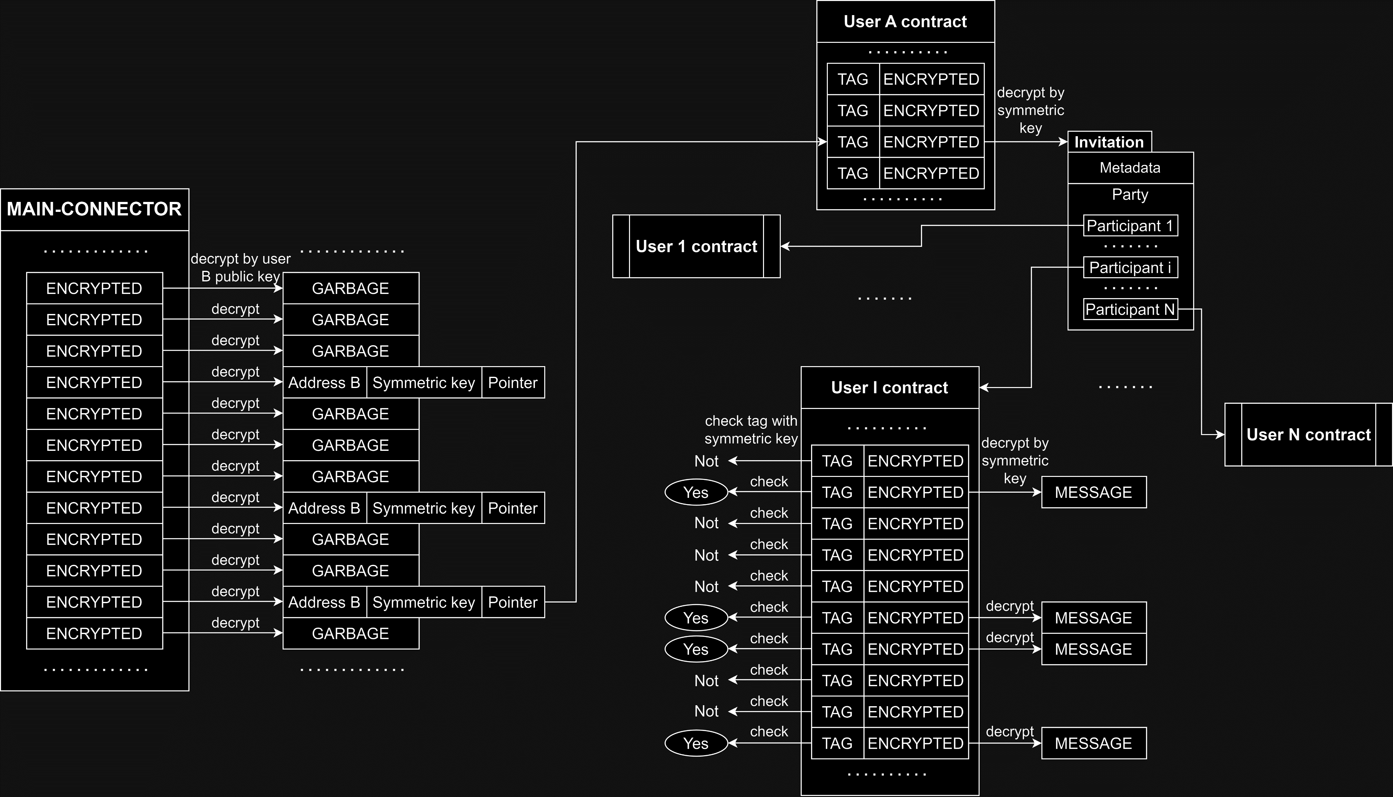
example illustration

Slide 12


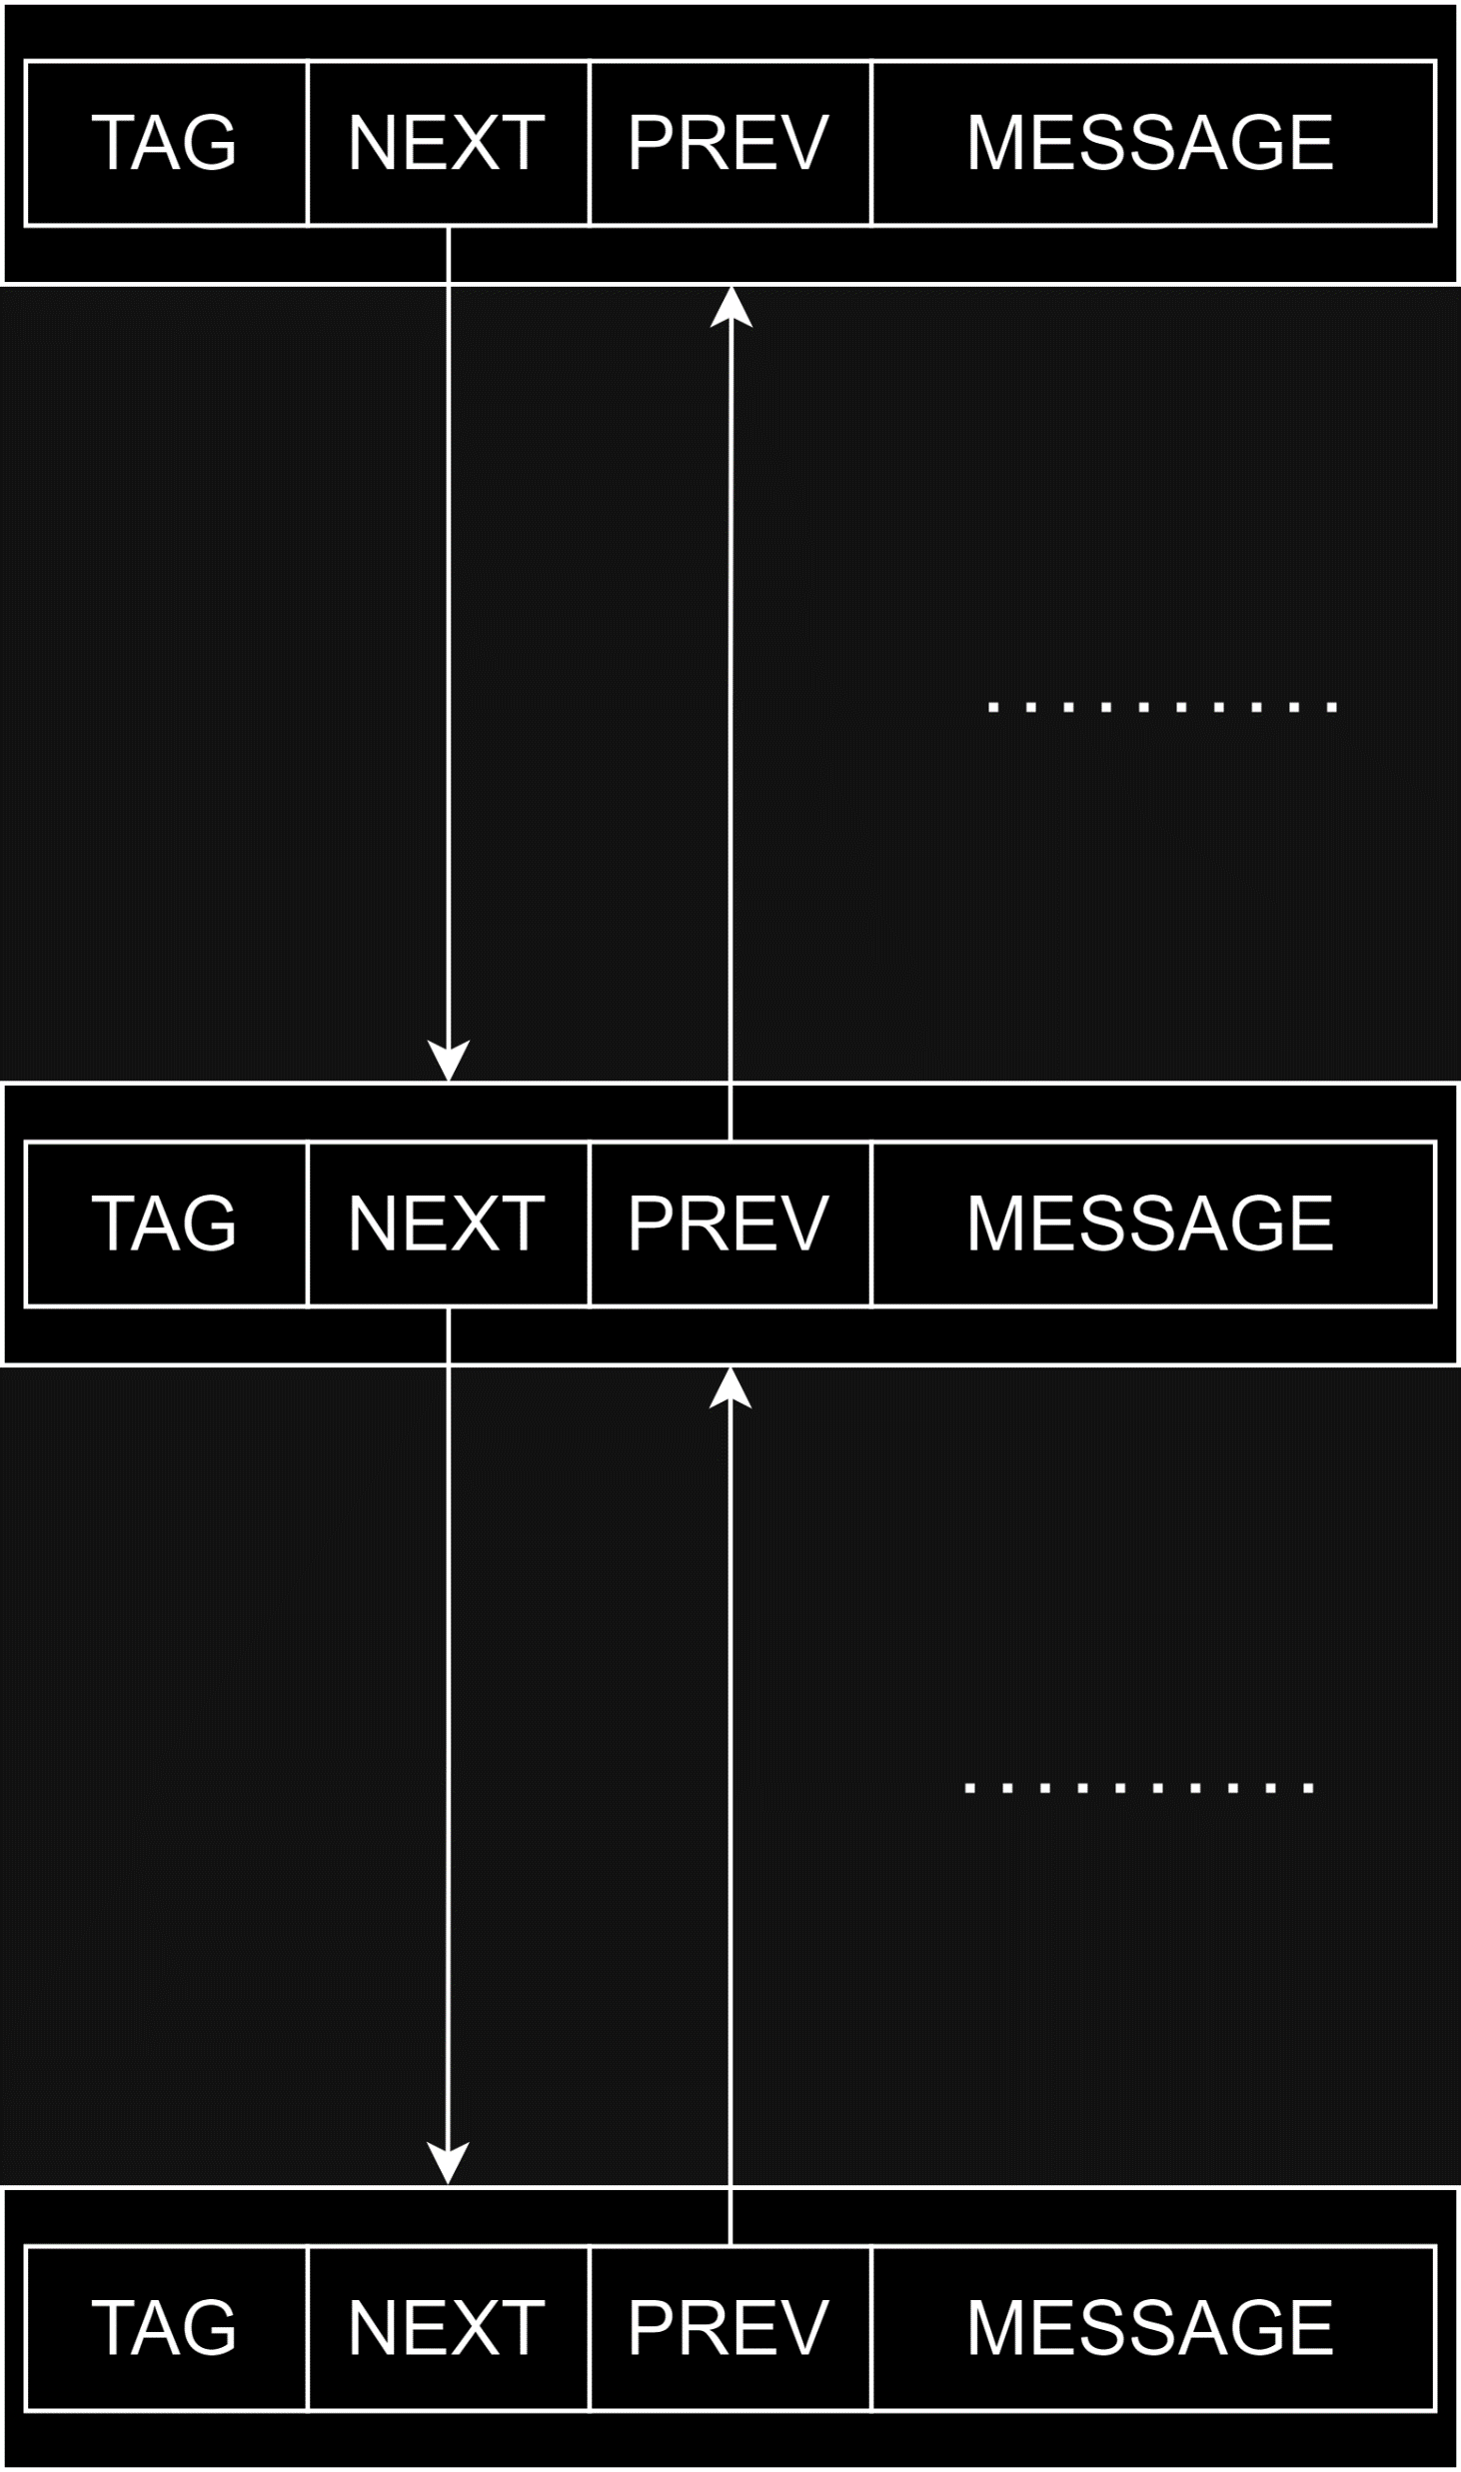
Future improvements
Pointer to previous message:
- good when you join new chat and need to load older messages
- not so interesting, obviously you not so often join new chat
- very easy to implement since you write a pointer to the previous message right while writing a new message
Pointer to next message:
- good when you haven’t opened messenger for a long time and need to load new messages - interesting, because when you come back, you want to know what new things have happened and what has changed during your absence
- hard to implement because when writing a new message, you need to change the pointer from the previous message, but this way everyone will understand what this pointer points to
change random previous values
always change right back value and one random

Slide 13
evaluating the speed of this approach
Join new chat:
100 participants
user writes 10,000 messages per month
1 micro second per checking tag
1 second per month to determine the position of the required messages of one chat
Record decryption in Main-Contract (assume that the user has not logged into the messenger for a month):
10,000,000 records per month
35 micro seconds (on my PC) per decryption record (new asymmetric system for keys exchanges Kyber, specifically kyber90s512)
6 minutes per month to decrypt all records in Main-Connect
Good links:
Speed of many encryption algorithms: bench.cr.yp.to/results-kem.html
Disadvantages of various messengers: adamant.im/comtable

